Slide 1

BANK MARKETING
PALLAVI THATTI

Slide 2
Problem statement… Our Understanding
The data is related with direct marketing campaigns of a Portuguese banking Institution. The Market campaigns were based on phone calls. Often, more than one contact to the same client was required, in order to access if the product (bank term deposit) would be(‘yes’) or not(‘no’) subscribed.
Objective: To predict whether the client will subscribe a term deposit or not (variable y).
    Yes (1)
    No (0)

Slide 3
CONTENTS
Data Characteristics
Data Pre-processing
Model Building

Slide 4
Data Characteristics
Type of Problem : Classification
No of Records : 41188
No of Attributes : 21
Type of Target Attribute : Binary(yes or no)
Type of Variables: Factor and Numerical
Y was identified to be the target variable

Slide 5
Data characteristics continued….
Class Imbalance(80-10)
Error Metrics : Sensitivity
Going to predict the client is subscribed for term deposit.

Slide 6
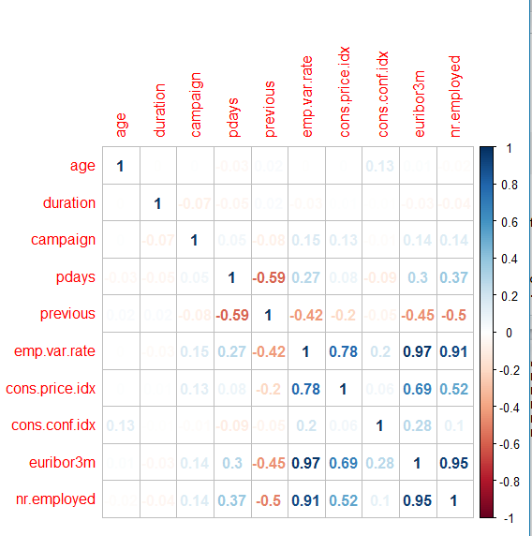
Correlation Plot

Slide 7
Pre-processing
No of missing values observed :12178.
Hence central imputation is required.
Using SMOTE for class balance.
Library used : Caret

Slide 8
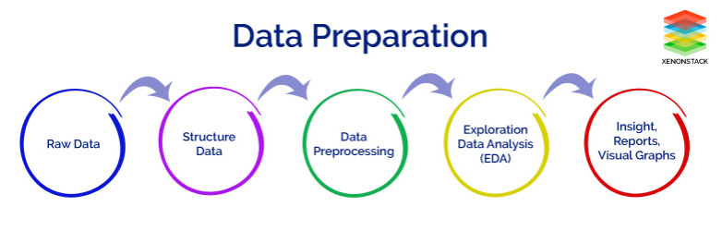
Data Preparation
Pre-Processing steps followed

Slide 9
Data Preprocessing, PCA
Data Preprocessing is a technique that is used to convert the raw data into a clean data set
(PCA) is to reduce the dimensionality of a data set consisting of many variables correlated with each other.

Slide 10
Analysis for selecting the model
Models without smote ,with smote and PCA consideration
  Logistic regression
  Random Forest
  SVM
  KNN
  Decision trees
  Bagging
  GBM
  XGBOOST
Feature reduction
  PCA

Slide 11
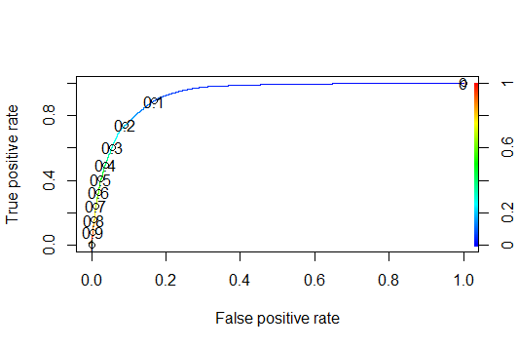
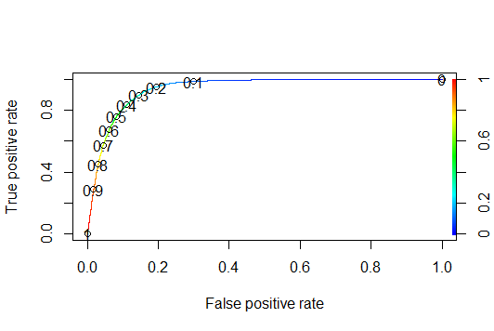
Logistic regression-ROC Curve
AUC-0.93(without smote)
AUC-0.94(with smote)
Notes:
0.93

Slide 12
Logistic regression (without and with Smote Data)
TEST DATA TRAIN DATA
Accuracy : 0.84 Accuracy : 0.84
Sensitivity : 0.40 Sensitivity : 0.41
Specificity : 0.98 Specificity : 0.98
TEST DATA TRAIN DATA
Accuracy : 0.89 Accuracy : 0.89
Sensitivity : 0.52 Sensitivity : 0.52
Specificity : 0.96 Specificity : 0.96

Slide 13
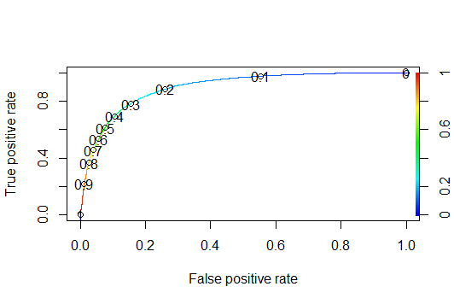
With PCA
AUC-0.90
TEST DATA TRAIN DATA
Accuracy : 0.84 Accuracy : 0.84
Sensitivity : 0.39 Sensitivity : 0.38
Specificity : 0.96 Specificity : 0.96

Slide 14
Random Forest (without and with Smote Data and also PCA)
TEST DATA TRAIN DATA
Accuracy : 0.84 Accuracy : 0.84
Sensitivity : 0.39 Sensitivity : 0.38
Specificity : 0.96 Specificity : 0.96
TEST DATA TRAIN DATA
Accuracy : 0.91 Accuracy : 0.97
Sensitivity : 0. 72 Sensitivity : 1
Specificity : 0.93 Specificity : 0.96
TEST DATA TRAIN DATA
Accuracy : 0.92 Accuracy : 0.99
Sensitivity : 0.99 Sensitivity : 0.62
Specificity : 0.99 Specificity : 0.66

Slide 15
KNN (without Smote Data and PCA)
TEST DATA TRAIN DATA
Accuracy : 0.90 Accuracy : 0.91
Sensitivity : 0.45 Sensitivity : 0.50
Specificity : 0.96 Specificity : 0.97
TEST DATA TRAIN DATA
Accuracy : 0.90 Accuracy : 0.91
Sensitivity : 0. 40 Sensitivity : 0.41
Specificity : 0.97 Specificity : 0.98

Slide 16
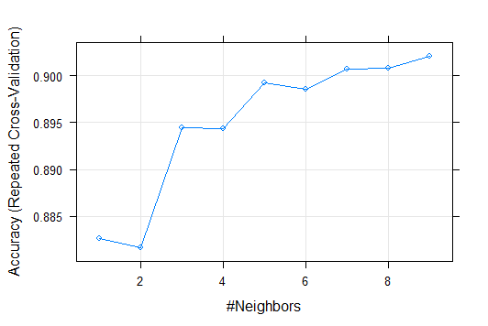
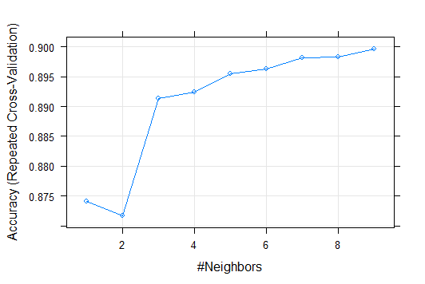
We can see variation in Accuracy w.r.t K value by plotting these in a graph.

Slide 17
SVM (kernel=linear)(without and with Smote Data and also PCA)
TEST DATA TRAIN DATA
Accuracy : 0.90 Accuracy : 0.89
Sensitivity : 0.27 Sensitivity : 0.28
Specificity : 0.97 Specificity : 0.98
TEST DATA TRAIN DATA
Accuracy : 0.89 Accuracy : 0.89
Sensitivity : 0. 75 Sensitivity : 0.76
Specificity : 0.90 Specificity : 0.91
TEST DATA TRAIN DATA
Accuracy : 0.88 Accuracy : 0.89
Sensitivity : 0.38 Sensitivity : 0.41
Specificity : 0.92 Specificity : 0.92

Slide 18
SVM (kernel=tanhdot)(without and with Smote Data and also PCA)
TEST DATA TRAIN DATA
Accuracy : 0.83 Accuracy : 0.84
Sensitivity : 0.28 Sensitivity : 0.29
Specificity : 0.90 Specificity : 0.90
TEST DATA TRAIN DATA
Accuracy : 0.74 Accuracy : 0.74
Sensitivity : 0. 48 Sensitivity : 0.48
Specificity : 0.77 Specificity : 0.77
TEST DATA TRAIN DATA
Accuracy : 0.90 Accuracy : 0.90
Sensitivity : 0.52 Sensitivity : 0.54
Specificity : 0.79 Specificity : 0.79

Slide 19
SVM (kernel=rbfdot)(without and with Smote Data )
TEST DATA TRAIN DATA
Accuracy : 0.90 Accuracy : 0.90
Sensitivity : 0.29 Sensitivity : 0.29
Specificity : 0.98 Specificity : 0.98
TEST DATA TRAIN DATA
Accuracy : 0.91 Accuracy : 0.91
Sensitivity : 0. 33 Sensitivity : 0.33
Specificity : 0.98 Specificity : 0.98

Slide 20
CART (without and with Smote Data and also PCA)
TEST DATA TRAIN DATA
Accuracy : 0.91 Accuracy : 0.91
Sensitivity : 0.49 Sensitivity : 0.51
Specificity : 0.96 Specificity : 0.96
TEST DATA TRAIN DATA
Accuracy :0.89 Accuracy : 0.89
Sensitivity : 0. 74 Sensitivity : 0.74
Specificity : 0.91 Specificity : 0.91
TEST DATA TRAIN DATA
Accuracy : 0.85 Accuracy : 0.85
Sensitivity : 0.44 Sensitivity : 0.45
Specificity : 0.89 Specificity : 0.89

Slide 21
C50 (without and with Smote Data and also PCA)
TEST DATA TRAIN DATA
Accuracy : 0.92 Accuracy : 0.92
Sensitivity : 0.54 Sensitivity : 0.58
Specificity : 0.97 Specificity : 0.96
TEST DATA TRAIN DATA
Accuracy :0.93 Accuracy : 0.90
Sensitivity : 0. 81 Sensitivity : 0.74
Specificity : 0.95 Specificity : 0.93
TEST DATA TRAIN DATA
Accuracy : 0.92 Accuracy : 0.89
Sensitivity : 0.73 Sensitivity : 0.66
Specificity : 0.94 Specificity : 0.93

Slide 22
Bagging (with Smote Data and PCA)
TEST DATA TRAIN DATA
Accuracy : 0.85 Accuracy : 0.85
Sensitivity : 0.84 Sensitivity : 0.84
Specificity : 0.85 Specificity : 0.85
TEST DATA TRAIN DATA
Accuracy :0.88 Accuracy : 0.88
Sensitivity : 0. 70 Sensitivity : 0.70
Specificity : 0.90 Specificity : 0.90

Slide 23
GBM (without and with Smote Data and also PCA)
TEST DATA TRAIN DATA
Accuracy : 0.86 Accuracy : 0.87
Sensitivity : 0.91 Sensitivity : 0.91
Specificity : 0.86 Specificity : 0.85
TEST DATA TRAIN DATA
Accuracy :0.87 Accuracy : 0.88
Sensitivity : 0. 88 Sensitivity : 0.88
Specificity : 0.87 Specificity : 0.88
TEST DATA TRAIN DATA
Accuracy : 0.82 Accuracy : 0.82
Sensitivity : 0.73 Sensitivity : 0.65
Specificity : 0.93 Specificity : 0.95

Slide 24
XGBOOST (without and with Smote Data and also PCA)
TEST DATA TRAIN DATA
Accuracy : 0.98 Accuracy : 0.91
Sensitivity : 0.96 Sensitivity : 0.80
Specificity : 0.97 Specificity : 0.93
TEST DATA TRAIN DATA
Accuracy :0.98 Accuracy : 0.91
Sensitivity : 0. 98 Sensitivity : 0.93
Specificity : 0.95 Specificity : 0.70
TEST DATA TRAIN DATA
Accuracy : 0.96 Accuracy : 0.91
Sensitivity : 0.95 Sensitivity : 0.75
Specificity : 0.97 Specificity : 0.92

Slide 25
Thank-You

